Slide 1


Slide 2
FM MODULATION & DEMODULATION USING FREQUENCY DISCRIMINATION METHOD

Slide 3
GROUP MEMBERS
S.N0. | GROUP MEMBERS | CMS ID
1 | MUHAMMAD HAMZA | 290951
2 | Ch. MUHAMMAD SHAHEER YASIR | 286021
3 | M SHAYAN KHAN MANJ | 310591
4 | ABDULLAH JAMIL | 295474

Slide 4
CONTENTS
INTRODUCTION
FREQUENCY MODULATION
FREQUENCY DEMODULATION
FM MODULATION TECHNIQUES
SIMPLE SLOPE DETECTOR
SOFTWARE IMPLEMENTATION
HARDWARE IMPLEMENTATION
APPLICATIONS
ADVANTAGES/DISADVANTAGES
CONCLUSION

Slide 5
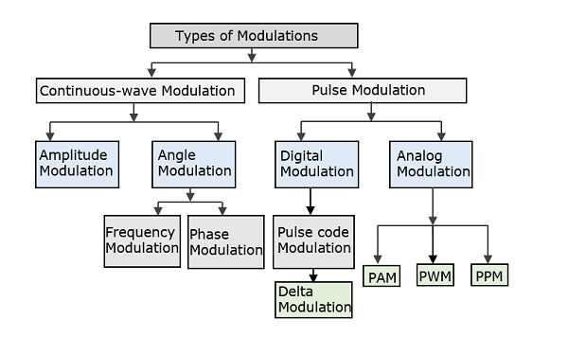
INTRODUCTION

Slide 6
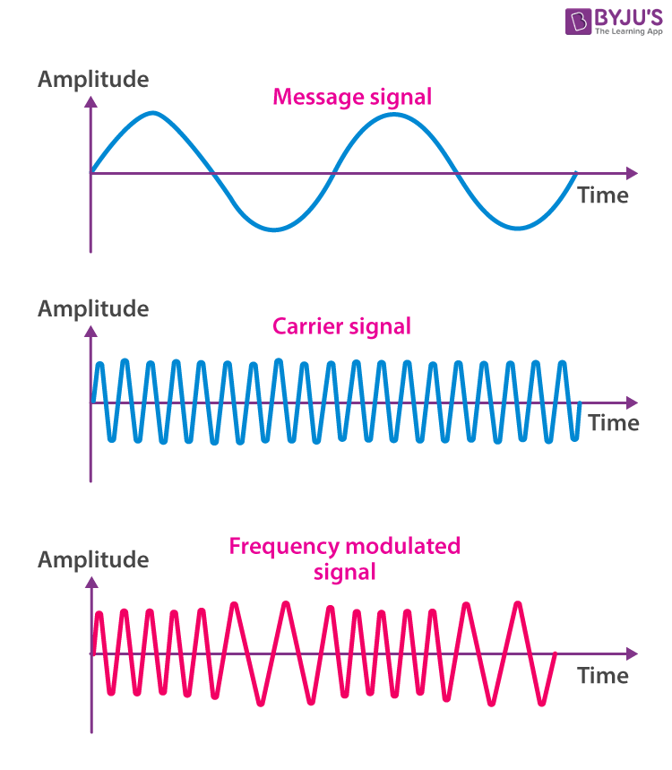
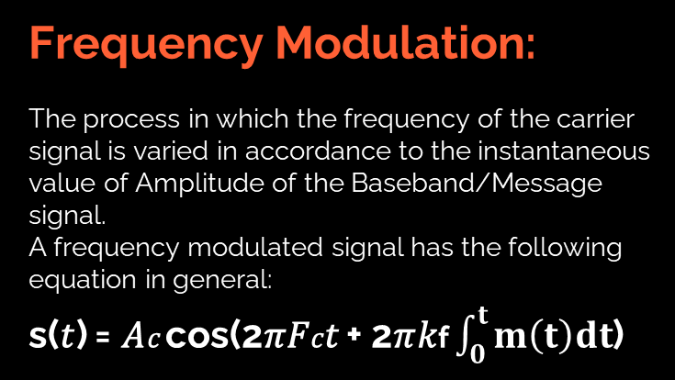
INTRODUCTION
Frequency Modulation:
The process in which the frequency of the carrier signal is varied in accordance to the instantaneous value of Amplitude of the Baseband/Message signal.
A frequency modulated signal has the following equation in general:
s(𝑡) = 𝐴𝑐 cos(2𝜋𝐹𝑐𝑡 + 2𝜋𝑘f $\int_{0}^{t}{m\left(t\right)dt}$)

Slide 7
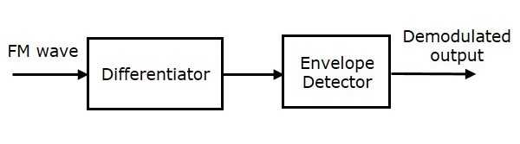
INTRODUCTION
Frequency Demodulation:
It is the reverse process of the modulation in which the message signal is extracted from the modulated signal using different schemes.A frequency demodulating scheme has the following block in general:

Slide 8
FM MODULATION TECHNIQUES
Following methods are used in FM modulation.
Using Differentiator ( for converting the frequency changes in FM to amplitude changes in the signal.)
Frequency discrimination method.
A frequency discriminator is a device that converts a received FM signal into a voltage that is proportional to the instantaneous frequency of its input without using a local oscillator and, consequently, in a non-coherent manner.
i- Simple Slope Detector
ii-Balanced FM Slope Detector
Phase discrimination method ( Foster Seeley FM Demodulator)

Slide 9
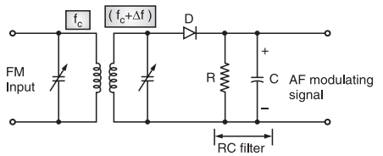
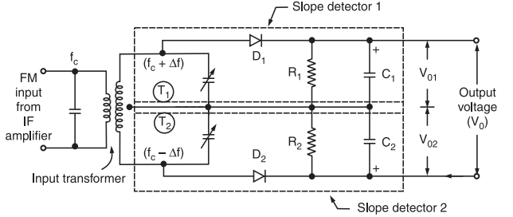
Frequency Discrimination Methods
i- Simple Slope Detector ii-Balanced FM Slope Detector

Slide 10
Simple Slope Detector:
According to the principle of slope detector, the received FM signal is applied to an LC circuit whose output is an amplitude modulated signal. This signal is then passed to an Envelope detector, which uses a detector diode, D, along with an LC circuit to recover the modulating signal, Vo.

Slide 11
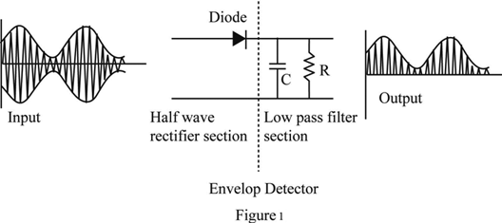
Envelope Detector:
Its an electronic circuit that takes a relatively high-frequency amplitude modulated signal as input and provides an output, which is the demodulated envelope of the original signal.
It consists of two main elements:
Diode / rectifier - serves to pass one half of the received signal over the other.
Low pass filter - required to remove the high frequency content that remains in the signal after detection / demodulation.

Slide 12

Simple Slope Detector:
Advantages:
It can be used to provide FM demodulation when only an AM detector is present.
Enables FM to be detected without any additional circuitry.
Disadvantages:
Non-linear characteristics of gain (Exact message signal cannot be reproduced)
Diff. tuned frequencies, (𝑓𝑐 , 𝑓𝑟 )
Both frequency and amplitude variations are demodulated and this means that much higher levels of noise is present.

Slide 13
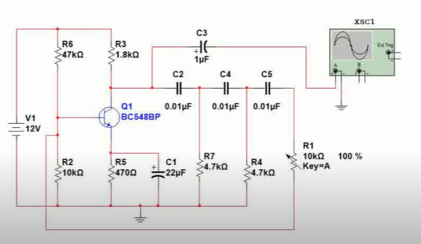
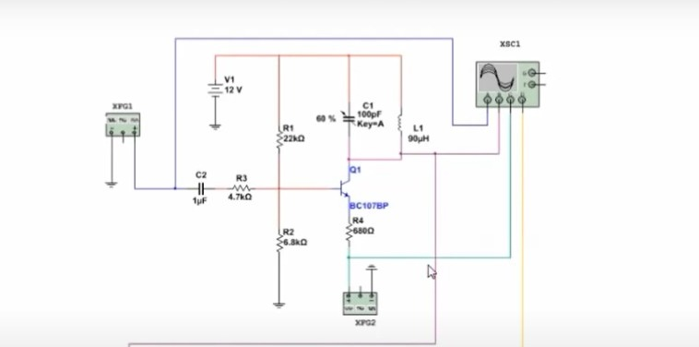
SOFTWARE IMPLEMENTATION:

Slide 14
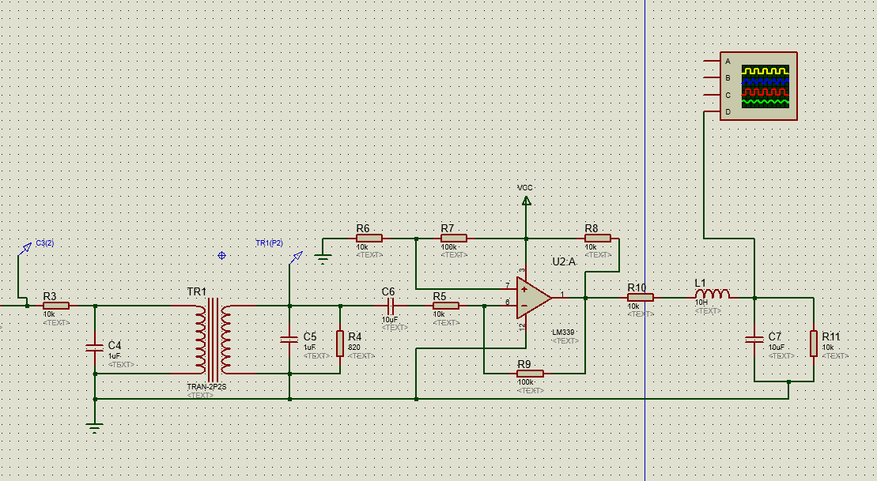
PROTEUS SCHEMATIC:

Slide 15
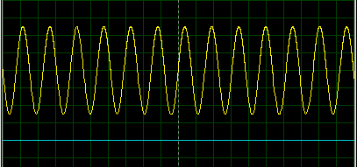
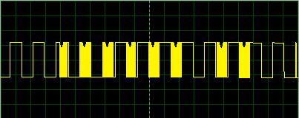
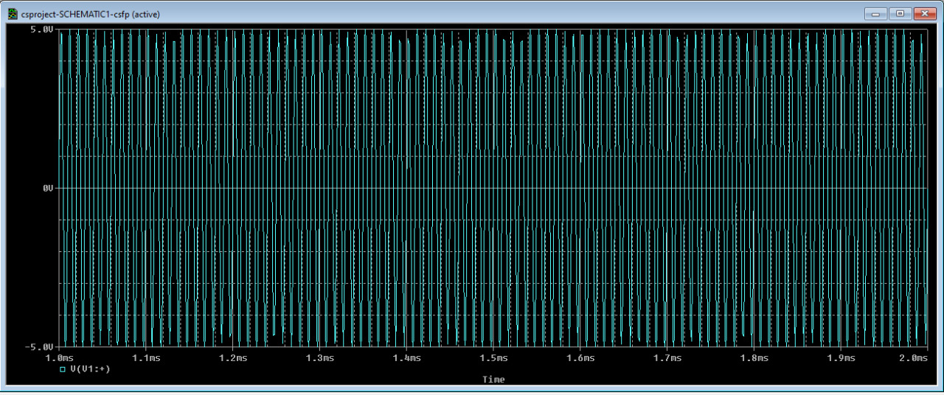
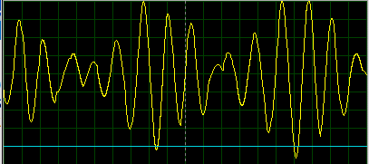
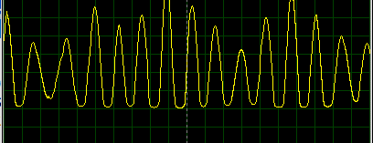
Results from Simulations:
MESSAGE SIGNAL
MODULATED SIGNAL
CARRIER SIGNAL
The carrier signal in our simulation is as follows:
The signal after passing through the differentiator in simulation is as follows:
The signal after passing through envelope detector is as follows:

Slide 16
Results from Simulations:
AFTER DIFFERENTIATOR:
AFTER ENVELOPE DETECTOR:
The carrier signal in our simulation is as follows:
The signal after passing through the differentiator in simulation is as follows:
The signal after passing through envelope detector is as follows:

Slide 17
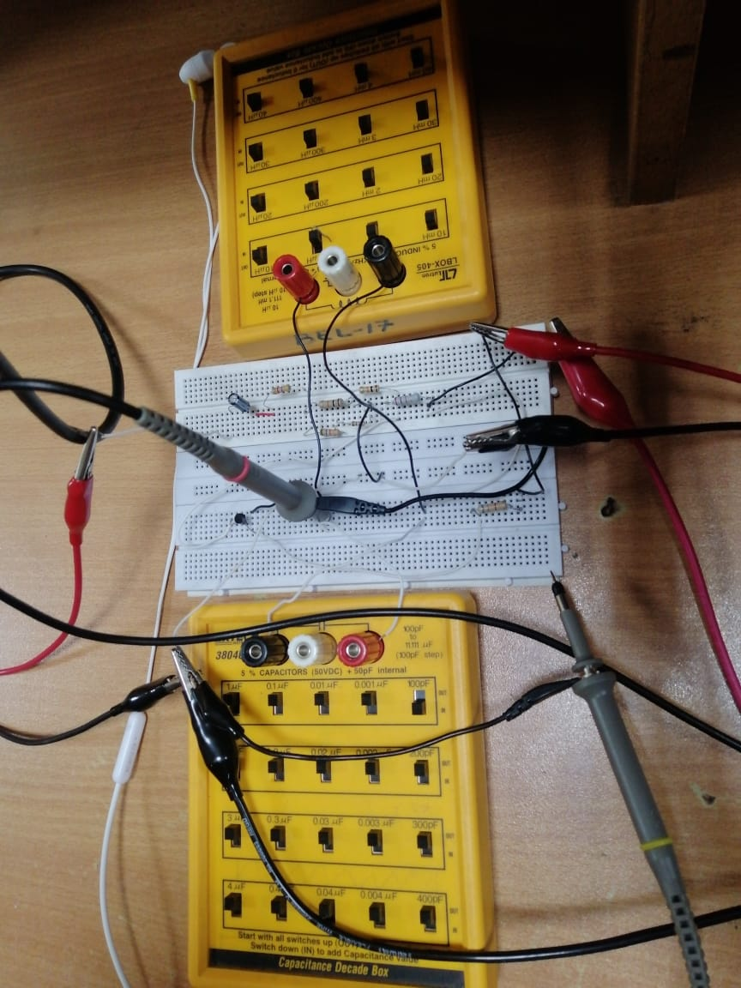
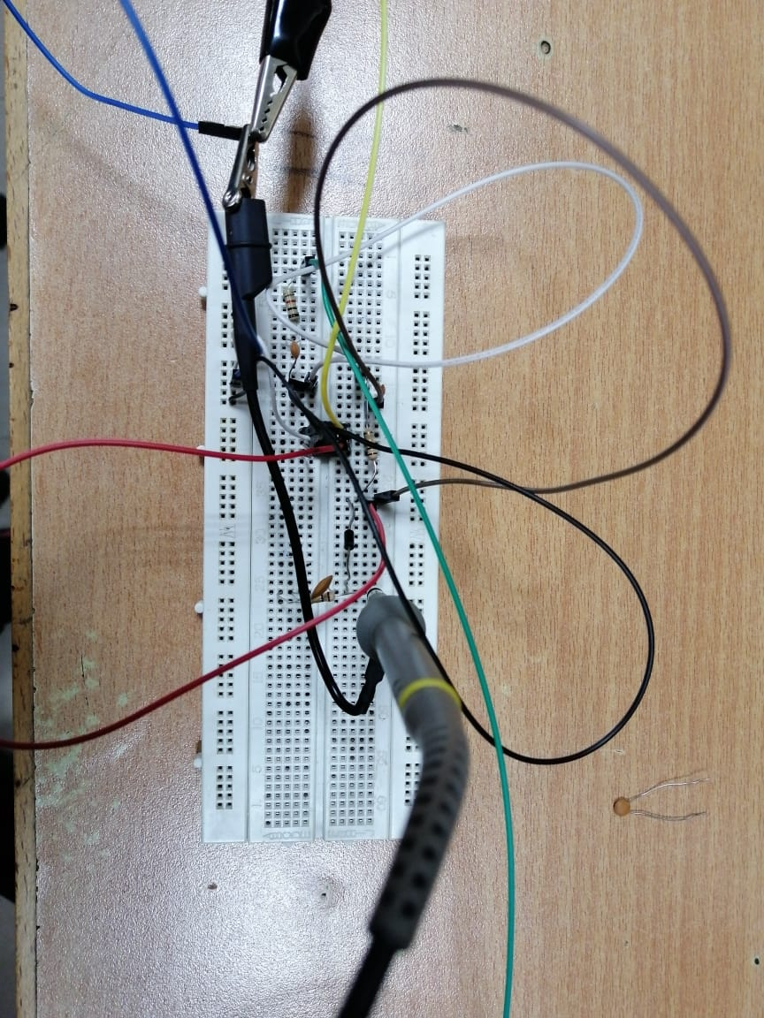
HARDWARE IMPLEMENTATION:
MODULATION
DEMODULATION

Slide 18
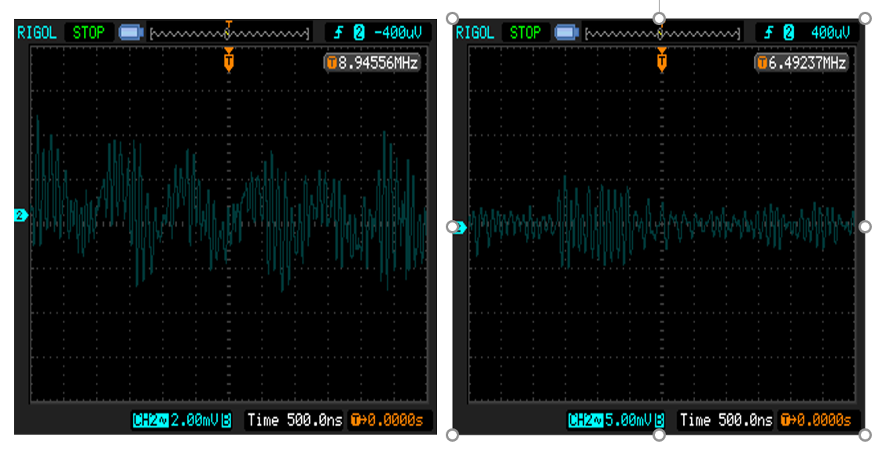
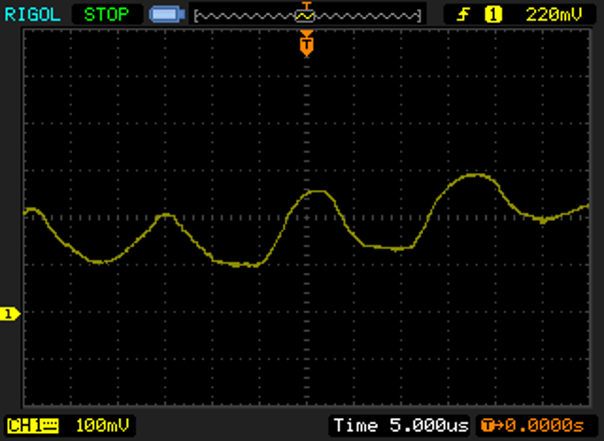
RESULT:

Slide 19
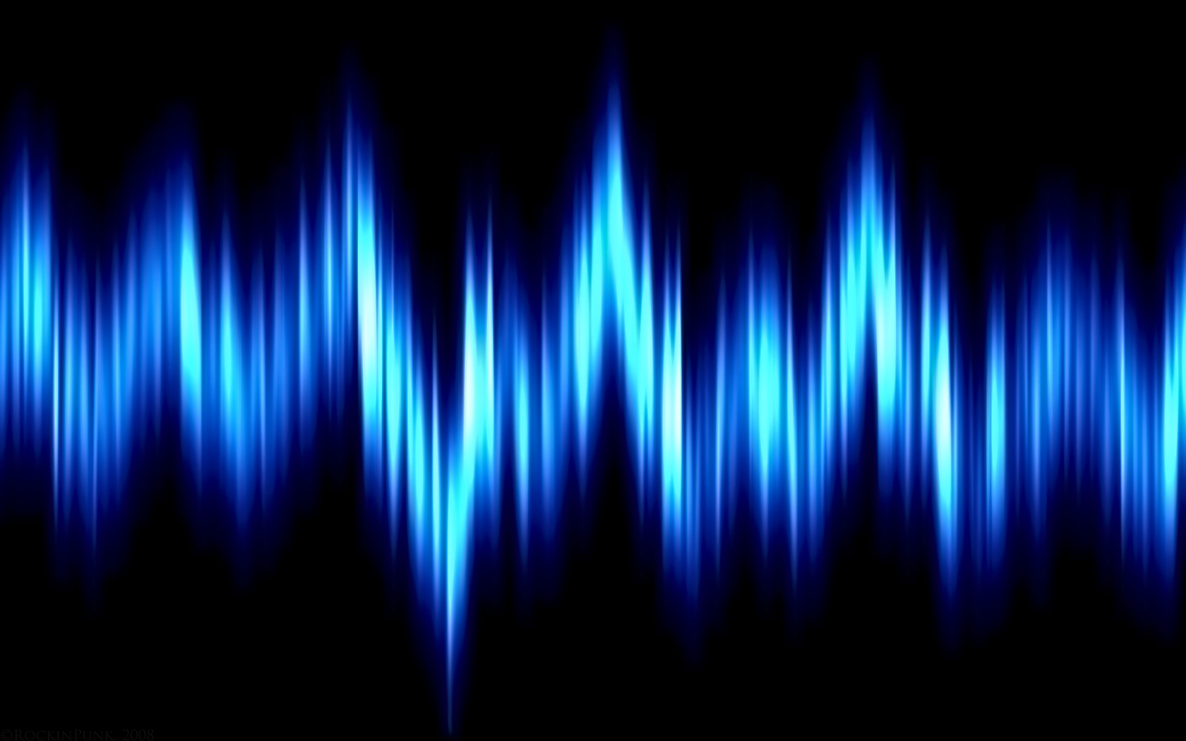

Limitations:
Not linear as the output is dependent upon the curve of a filter.
Not particularly effective as it requires the signal to be centered on the falling response of a filter. This means that the signal cannot be received at its maximum signal strength.
Both frequency and amplitude variations are demodulated, and this means that much higher levels of noise and interference are experienced.

Slide 20
Advantages/ Disadvantages
Advantages:
All the transmitted power in FM is useful, while in AM most of the transmitted power is in carrier which contains no information.
There is less power loss since the amplitude of FM is constant.
FM broadcast operates in the upper VHF and UHF range, where noise effects are minimal.
The noise in FM is reduced to a large extent by employing amplitude limiters to remove the amplitude variations caused by noise.
Disadvantages:
FM has infinite number of sidebands, while there are only two sidebands in AM.
The channel bandwidth in FM is much higher, up to 10-20 times as that of AM, whereas AM has narrow channel bandwidth which is 2fm.
The design of FM transmitter and receiver is relatively complex and expensive.

Slide 21

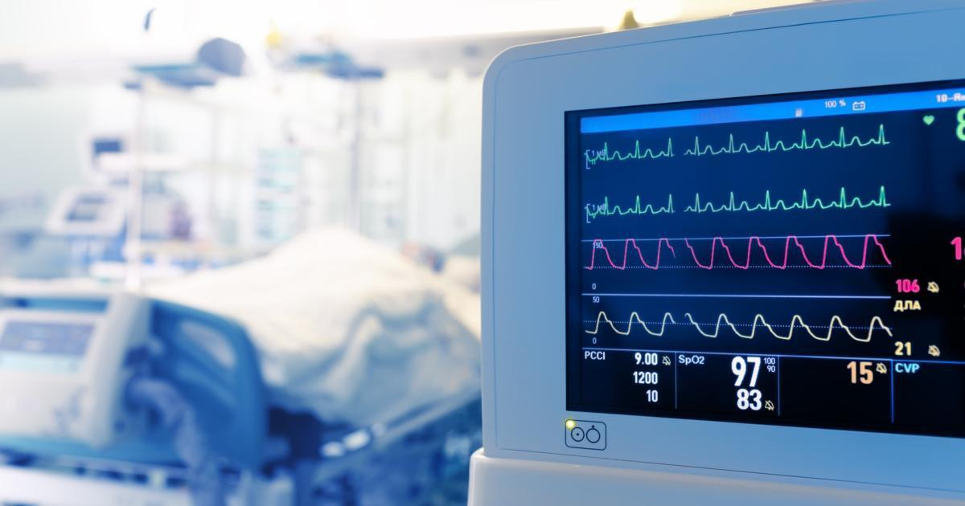
Applications of FM
FM radio broadcasting
Telemetry
Radar
Seismic prospecting and monitoring newborns for seizures via EEG
Two-way radio systems
Sound synthesis
Magnetic tape-recording systems
Sometimes in video-transmission systems.

Slide 22
References:
https://www.electronics-notes.com/articles/radio/modulation/fm-frequency-demodulation-slope-detector-discriminator.php
https://www.elprocus.com/frequency-modulation-and-its-applications/
https://www.tutorialspoint.com/analog_communication/analog_communication_anglemodulation.htm
http://www.winlab.rutgers.edu/~crose/322_html/envelope_detector.html
https://www.sciencedirect.com/topics/computer-science/envelope-detector

Slide 23
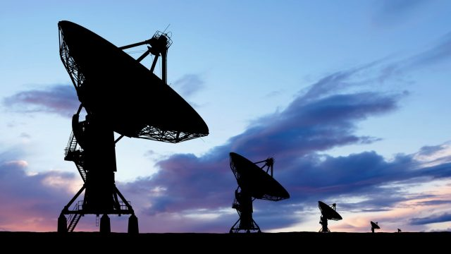
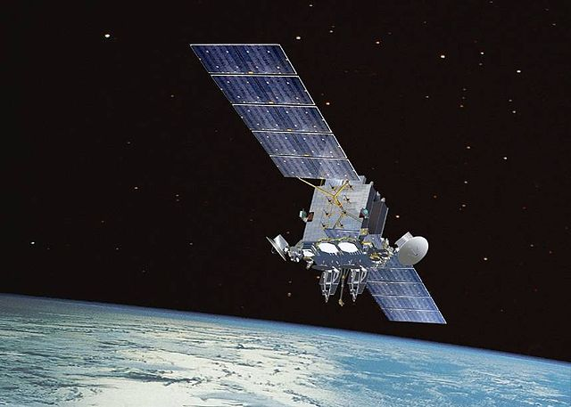
Conclusion:
In this project, we frequency modulated a message signal and then demodulated it using simple slope detector.
The simple slope detector is a differentiator along with an envelope detector. Its output is highly non-linear, and it has distortion in it due to which it’s not much preferable nowadays as compared to balanced slope detector and phase-locked loop.
Although all the components of this project were lost cost and easily accessible however the transformer required wasn’t available in the market. So, we designed our own transformer of the required ratings. We were to design a transformer with required ratings on our own which was beyond the scope of this course.

Slide 24
Thank You !

Slide 25
Any Questions!

